Slide 1
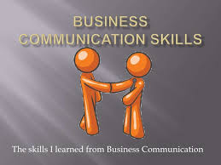
Business Communication skills

Slide 2
Table of contents
Business communication
Significance of communication skills
Example of communication skill
Necessity of business communication skills
  Valued in the workplace
  They enhance career progression
  They help in building better rapport with customers
  They enhance professional image
Conclusion
References

Slide 3

Business Communication
Communication in business organizations is vital because that is how information is sent or received.
Communication skills vary in business organizations, because they often depend on how a particular firm is structured.

Slide 4
Significance of communication skills
To convey a poised, clear and impactful message, one needs to be an engaging presenter with an ability to communicate with diverse personality varieties, using the fundamental communication skills such as questioning, listening and rapport building skills (Cenere et al. 2015).

Slide 5
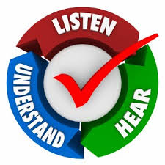
Example of business communication skill
Listening: knowing when to pause and allow the other person to converse is a substantial skill.
  Listening enables personnel to:
    show interest in what others say
    Deal with telephone conversations appropriately
    encourage interest and interaction from others in your team
    Express an opinion or asking a question clearly
    persuade other employees or subordinates

Slide 6
Why business communication skills are a necessity
Valued in the workplace
They enhance career progression
They help in building better rapport with customers
They enhance professional image

Slide 7

Valued in the workplace
The skill of listening prudently, speaking with audacity and learning turn taking is valuable in any organization as it enables workers to express an opinion and ask for clarifications clearly (Mishra et al. 2014).

Slide 8

Enhancing Career Progression
Good business communication skills enable employees and managers to achieve co-operation and effective teamwork, as they can effectively request for information, provide instructions, discuss problems, work in teams, or interact with colleagues and clients (Chiang & Suen, 2015).

Slide 9

Building better Rapport with Customers
Effective business communication skills can aid the organization personnel to make contact with the customer and have a meaningful engagement either over the phone or face to face (Pabel & Pearce, 2018).

Slide 10

Enhancing an employee or manager’s professional image
Through communicating effectively in speech and in written form, an employer can gauge a potential employees success (McMurray et al 2016). As such, conveying a positive image reflects an employee’s ability in handling tasks.

Slide 11
Conclusion
The significance of business communication skills cannot be ignored. Effective application and integration of business communication skills can create opportunities for interacting in a more constructive and productive way, ultimately making the place of work a positive and flourishing environ.

Slide 12
References
Cenere, P., Gill, R., Lawson, C., & Lewis, M. (2015). Communication Skills for Business Professionals 7. Cambridge University Press.
McMurray, S., Dutton, M., McQuaid, R., & Richard, A. (2016). Employer demands from business graduates. Education+ Training, 58(1), 112-132.
Mishra, K., Boynton, L., & Mishra, A. (2014). Driving employee engagement: The expanded role of internal communications. International Journal of Business Communication, 51(2), 183-202.
Chiang, J. K. H., & Suen, H. Y. (2015). Self-presentation and hiring recommendations in online communities: Lessons from LinkedIn. Computers in Human Behavior, 48, 516-524.
Pabel, A., & Pearce, P. L. (2018). Selecting humour in tourism settings–A guide for tourism operators. Tourism Management Perspectives, 25, 64-70.

